Slide 1
INTRODUCTION TO
ALGORITHMS
FOURTH EDITION

Slide 2
LECTURE NOTES FOR CHAPTER 21
Minimum Spanning Trees

Slide 3
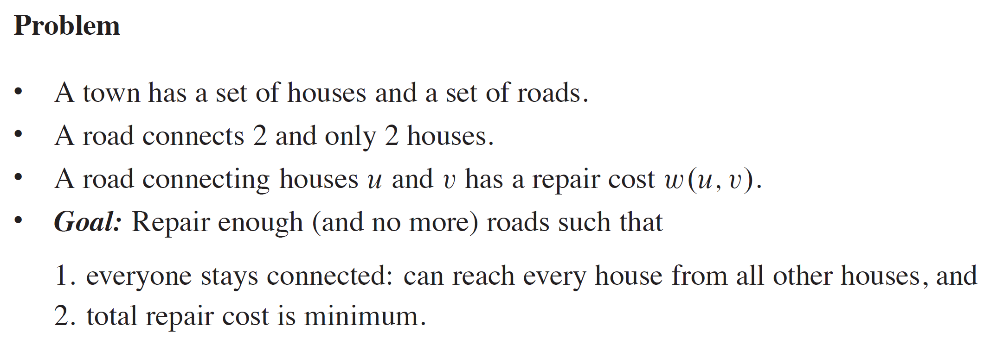
CHAPTER 21 OVERVIEW

Slide 4
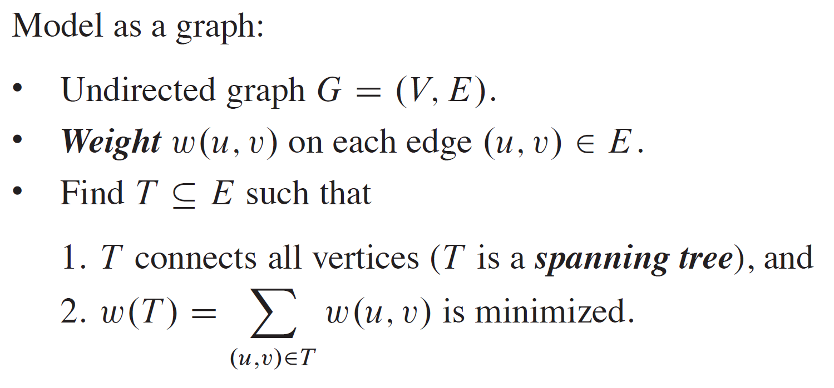
CHAPTER 21 OVERVIEW (continued)

Slide 5
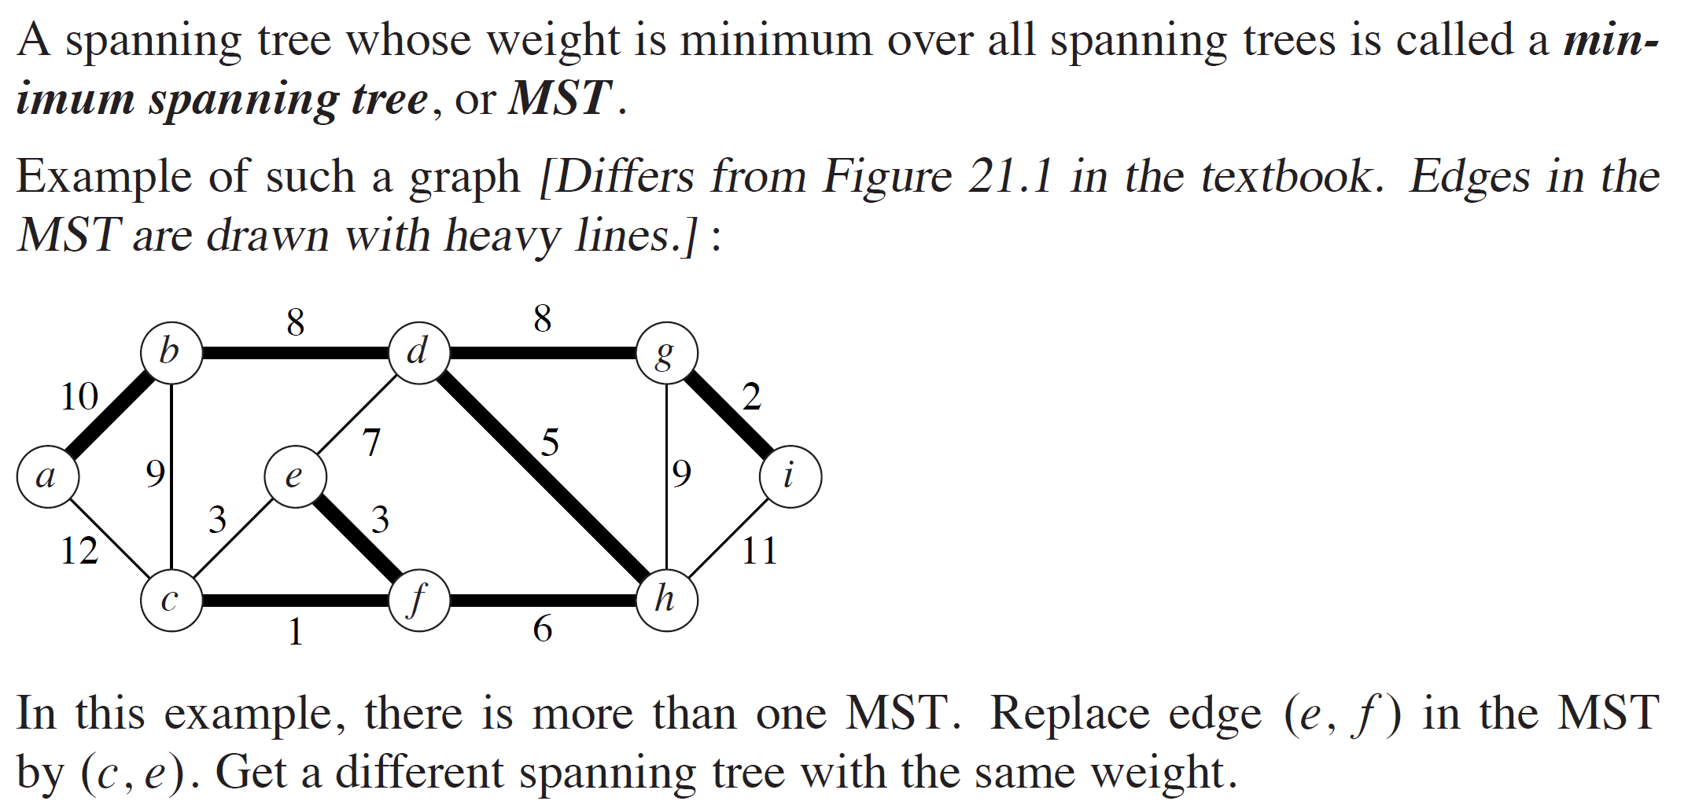
CHAPTER 21 OVERVIEW (continued)

Slide 6
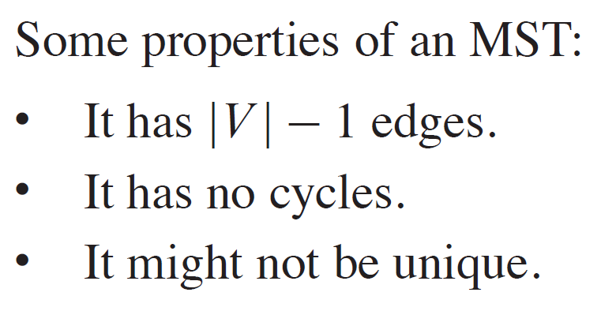
GROWING A MINIMUM SPANNING TREE

Slide 7
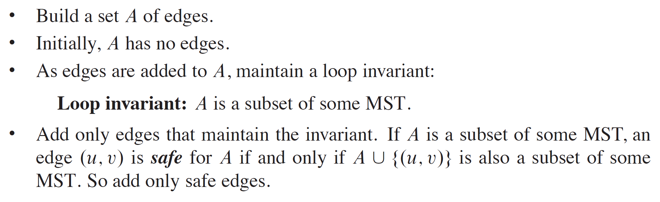
BUILDING UP THE SOLUTION

Slide 8
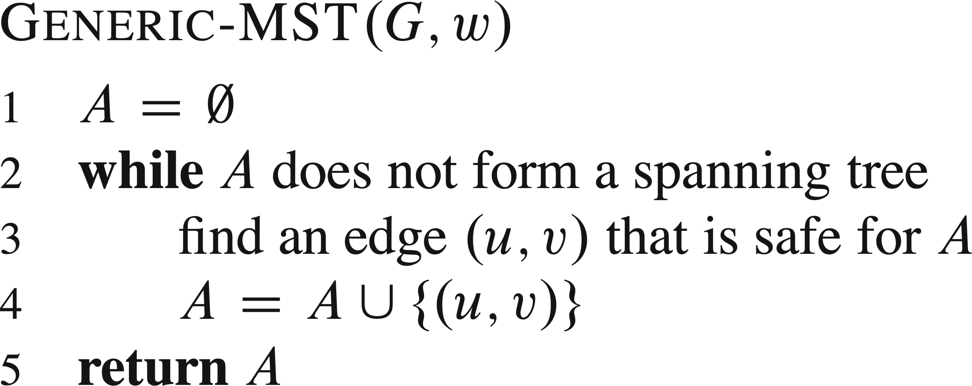
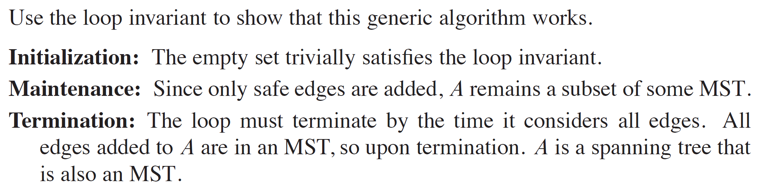
GENERIC MST ALGORITHM

Slide 9
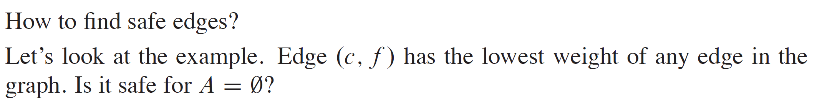
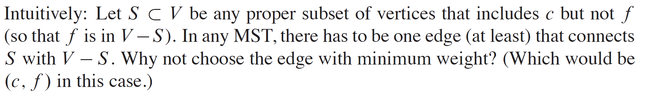
FINDING A SAFE EDGE

Slide 10
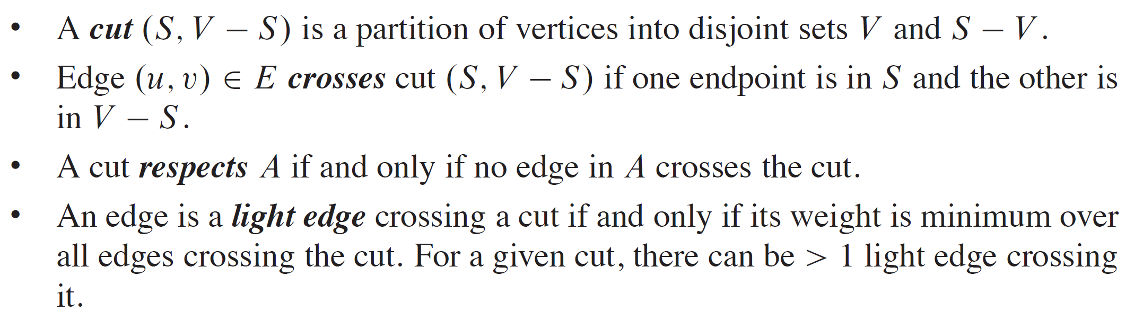
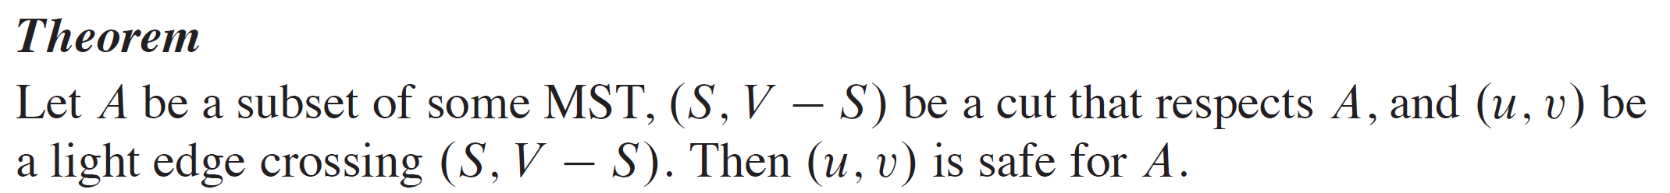
DEFINITIONS

Slide 11
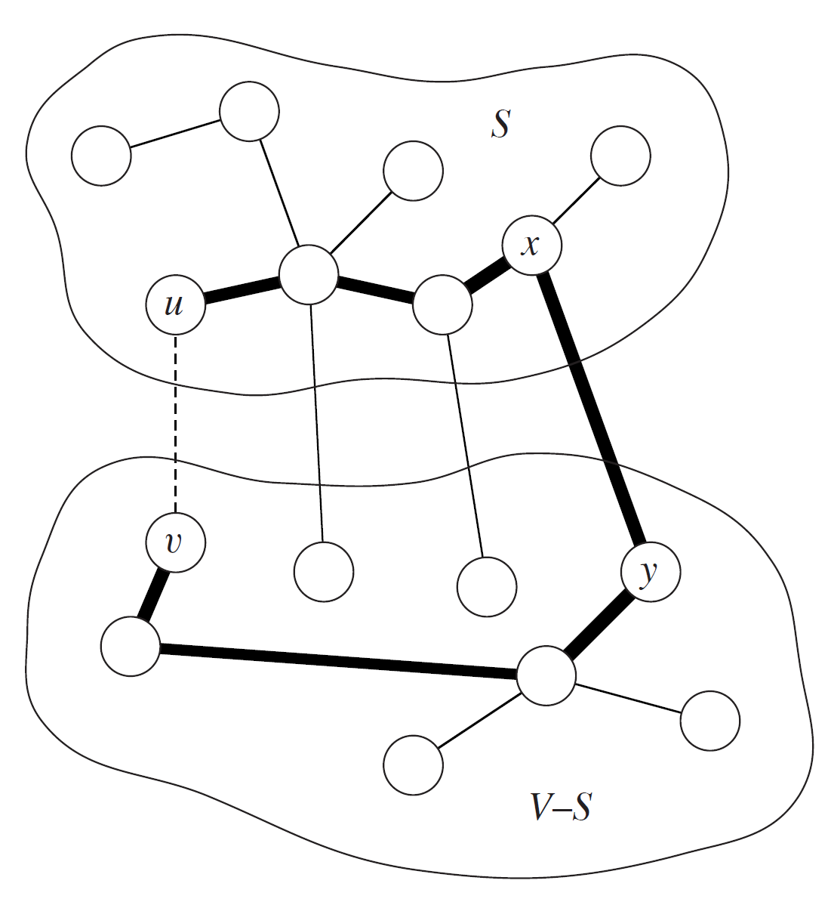
PROOF
Let (S, V-S) be a partition respecting A, a subset of some MST T. All drawn edges here are part of T except for (u,v), the light edge of the cut. If (u,v) is not in the tree, replacing (x,y) with (u,v) gives a new spanning tree with lower cost, a contradiction.

Slide 12
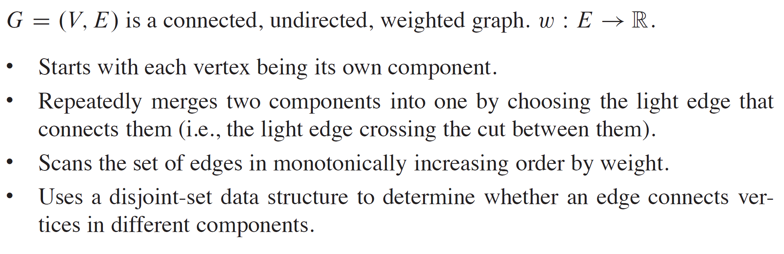
KRUSKAL’S ALGORITHM

Slide 13
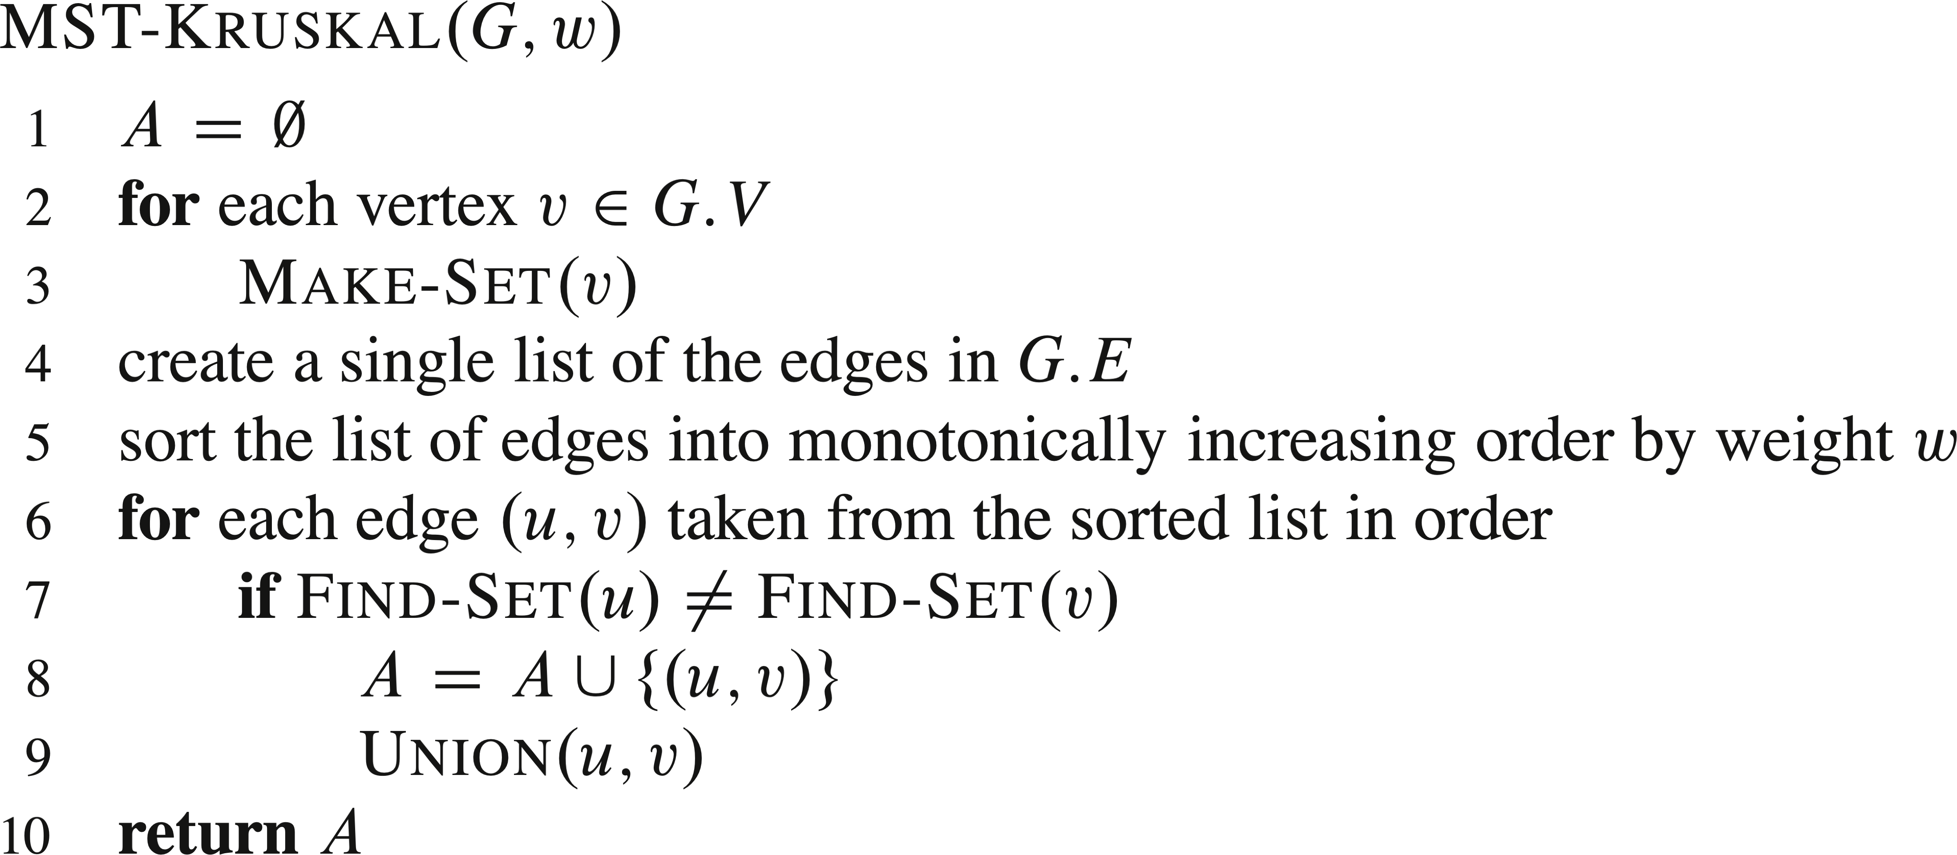
PSUEDOCODE

Slide 14
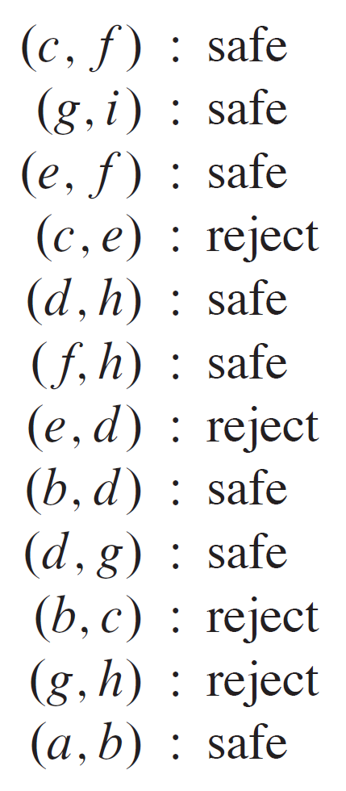
EXAMPLE
Let’s see Kruskal’s algorithm on this graph.

Slide 15
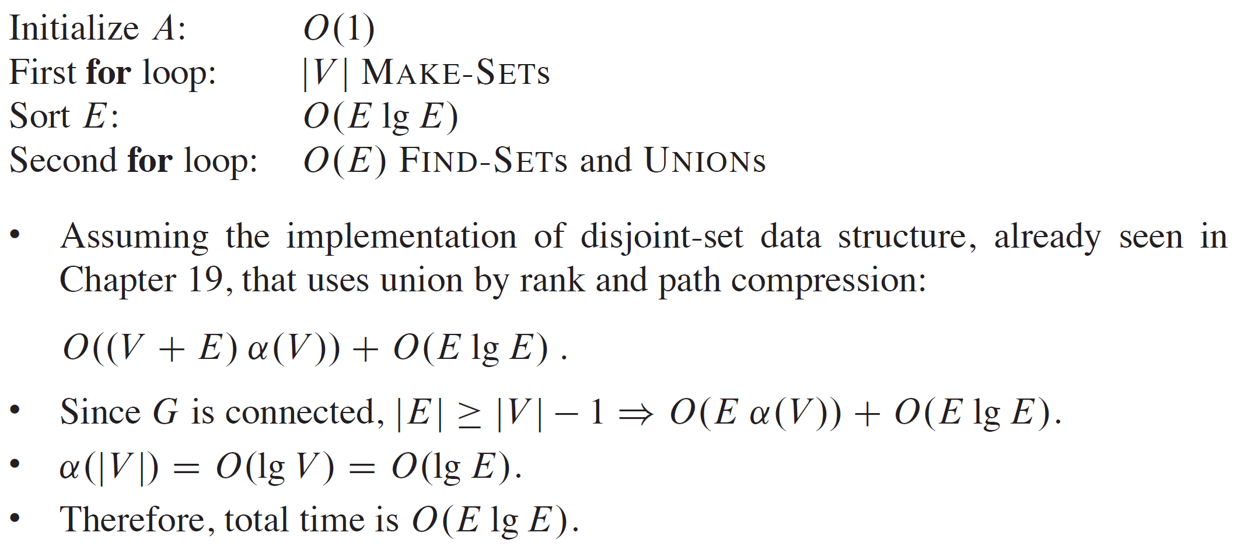
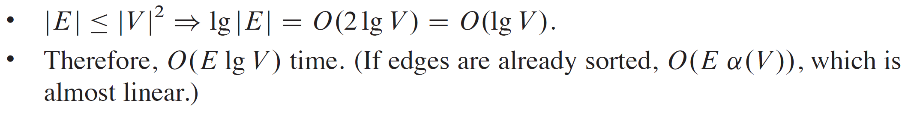
ANALYSIS

Slide 16
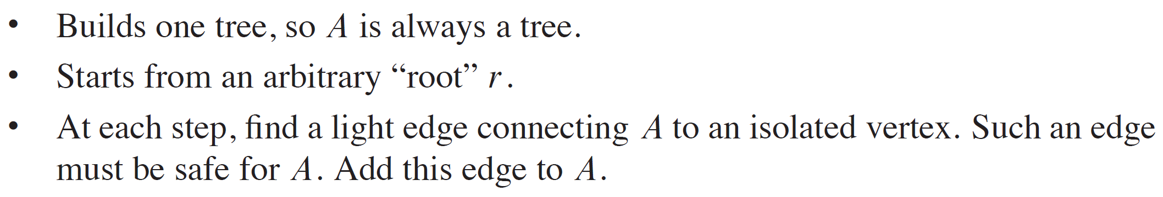
PRIM’S ALGORITHM

Slide 17
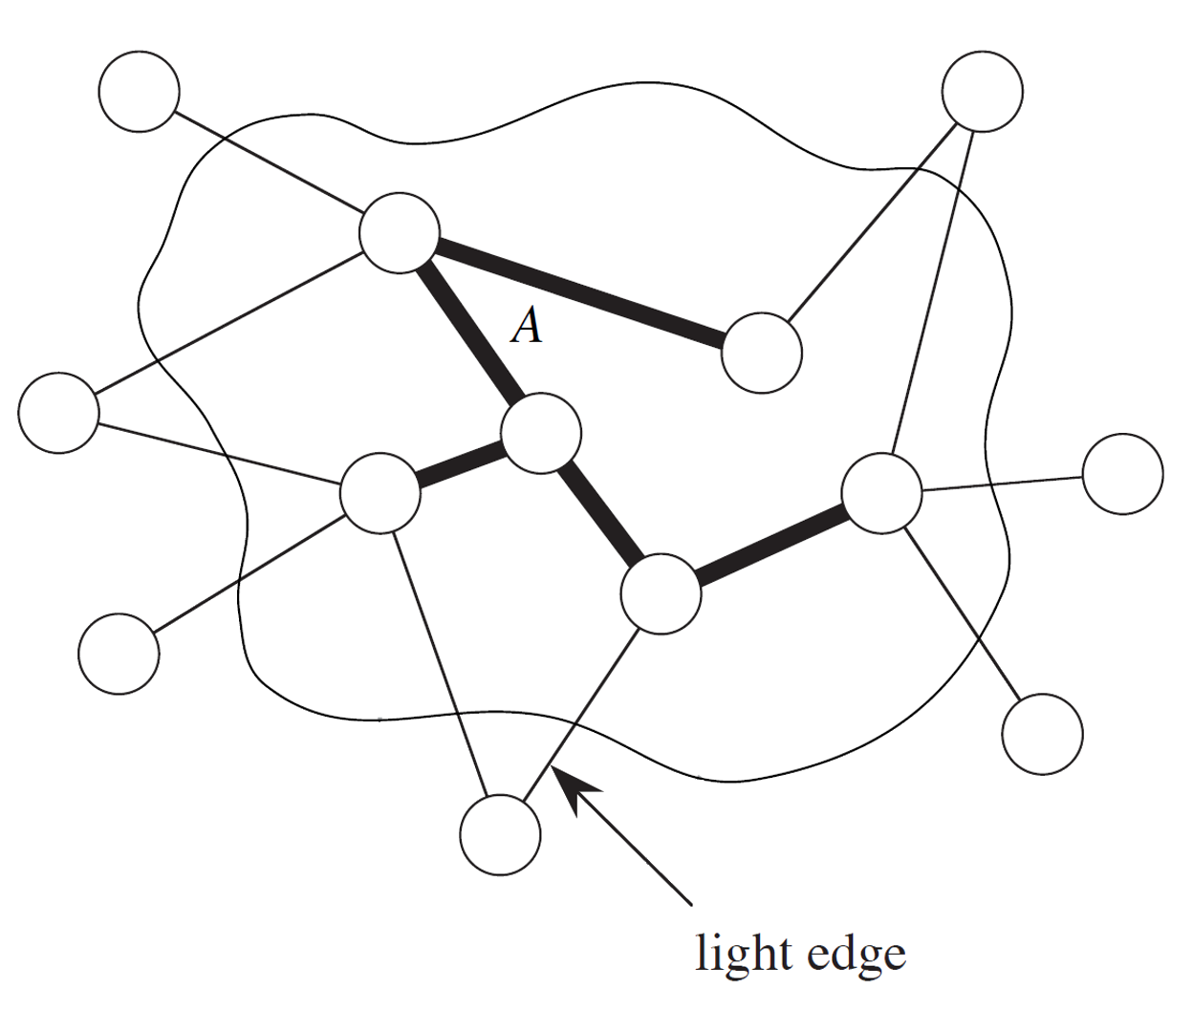
PRIM’S ALGORITHM (continued)

Slide 18
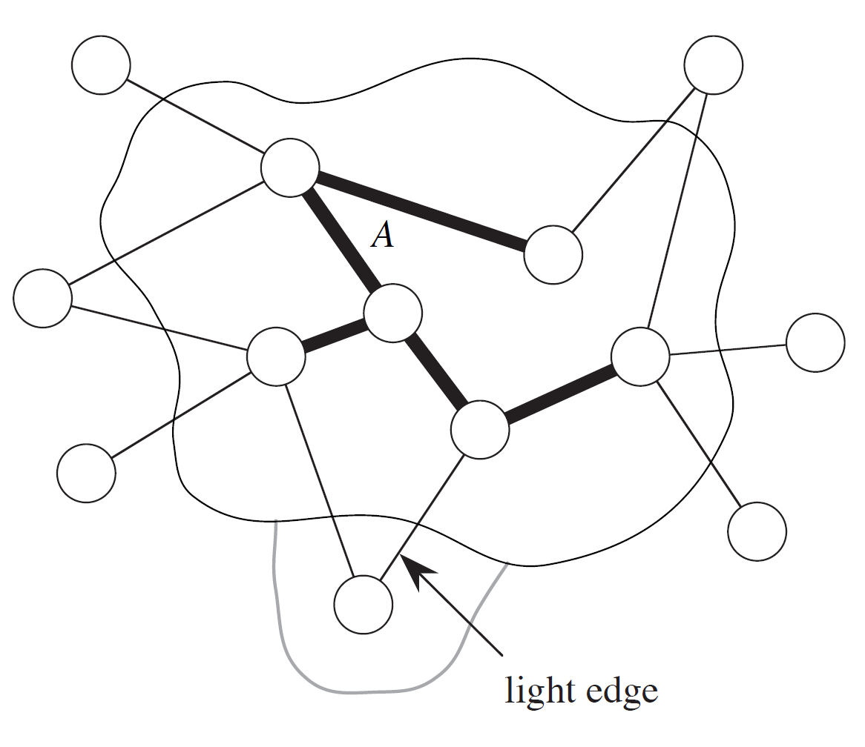
PRIM’S ALGORITHM (continued)

Slide 19
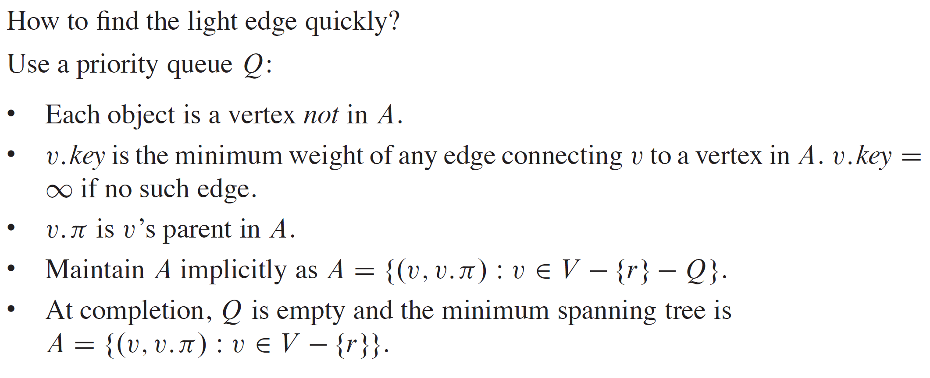
FINDING A LIGHT EDGE

Slide 20
EXAMPLE
Let’s see Prim’s algorithm on this graph. Pick a root.

Slide 21
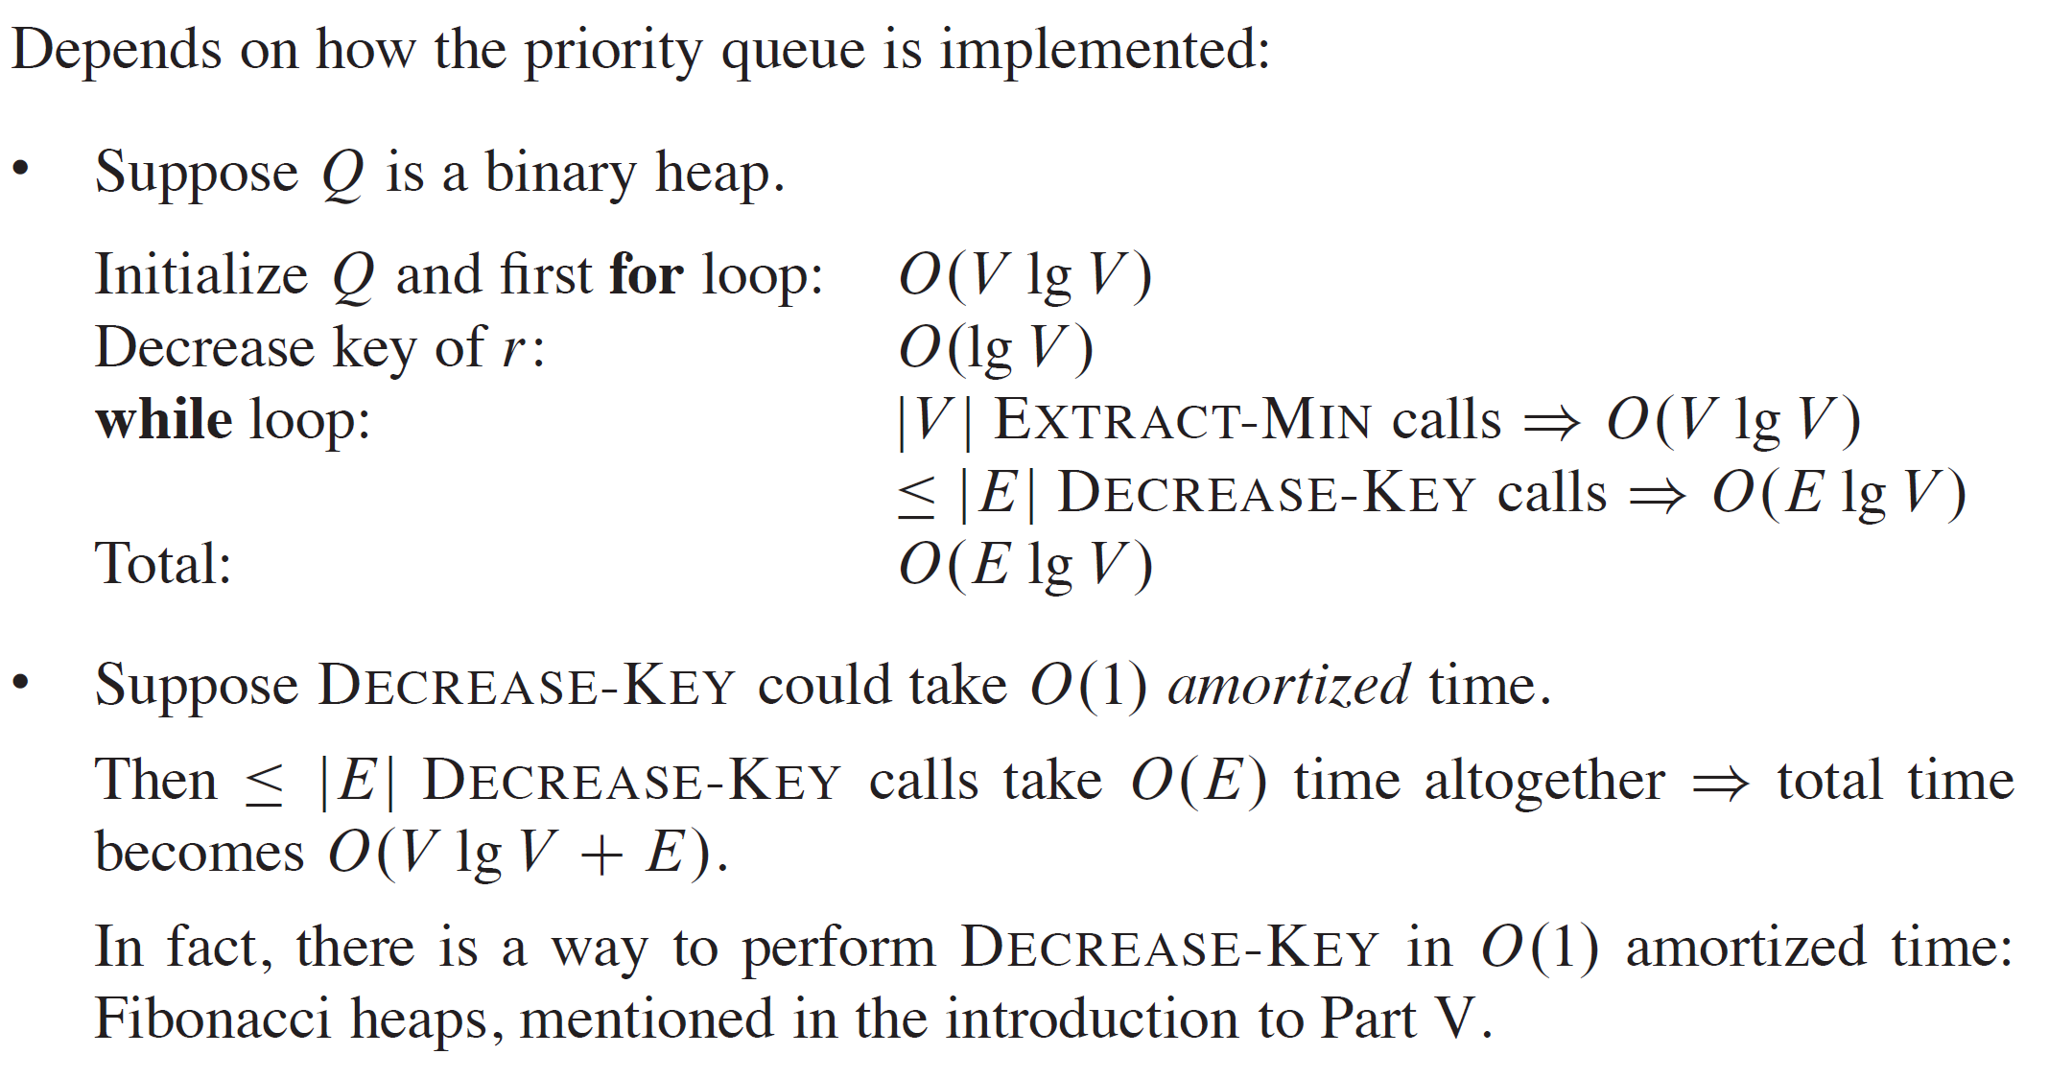
ANALYSIS

